Slide 1
Odoo Upgrade - Progress Reporting
August [02 to 06]

Slide 2

Overview

Slide 3
Overview
Project Documents and References:
Project Plan link:
https://docs.google.com/spreadsheets/d/18ZDAdHBzsEPdpr6rOwJDw2ViElgeVGW-ovWh-N8FheQ/edit?usp=sharing
Functional Test cases document:
https://docs.google.com/spreadsheets/d/12t1AjhoWo4CEOnC9snuApc7Y9-KMogo06I3qzkV-VHQ/edit?usp=sharing
UAT and Complete QA planning:
https://docs.google.com/spreadsheets/d/1zogqMJEMYcj1Ipb8xfOZKy1jcYYzcgeYiMnl-DUolIM/edit?usp=sharing

Slide 4
Progress Report -Aug [02 - 06]

Slide 5
Progress Report Summary - Aug [02 to 06]
Week Highlights: [August 02-06]
Modules Migration [By Verts Team]
Saarus:
VERTS team demonstrated all features.
KNK:
VERTS team progressing with internal testing, as per Atulya’s updates.
Data Migration [By Verts Team]
Saarus:
Data migration is in progress. VERTS team to fix some issues.
VERTS team to share Migrated database link by Wednesday (11/8).
Next Week Plan and Highlights: [August 09-13]
Modules Migration [By Verts Team]
Saarus:
UAT server to be setup for Saarus instance where KOKO team to start test run.
KNK:
Start the demo for the KNK Finance features.
Non finance modules are expected to start next week.
Data Migration [By Verts Team]
Saarus:
Data migration to be completed as per plan and share with KOKO team for review of data points including history and audit trail.

Slide 6
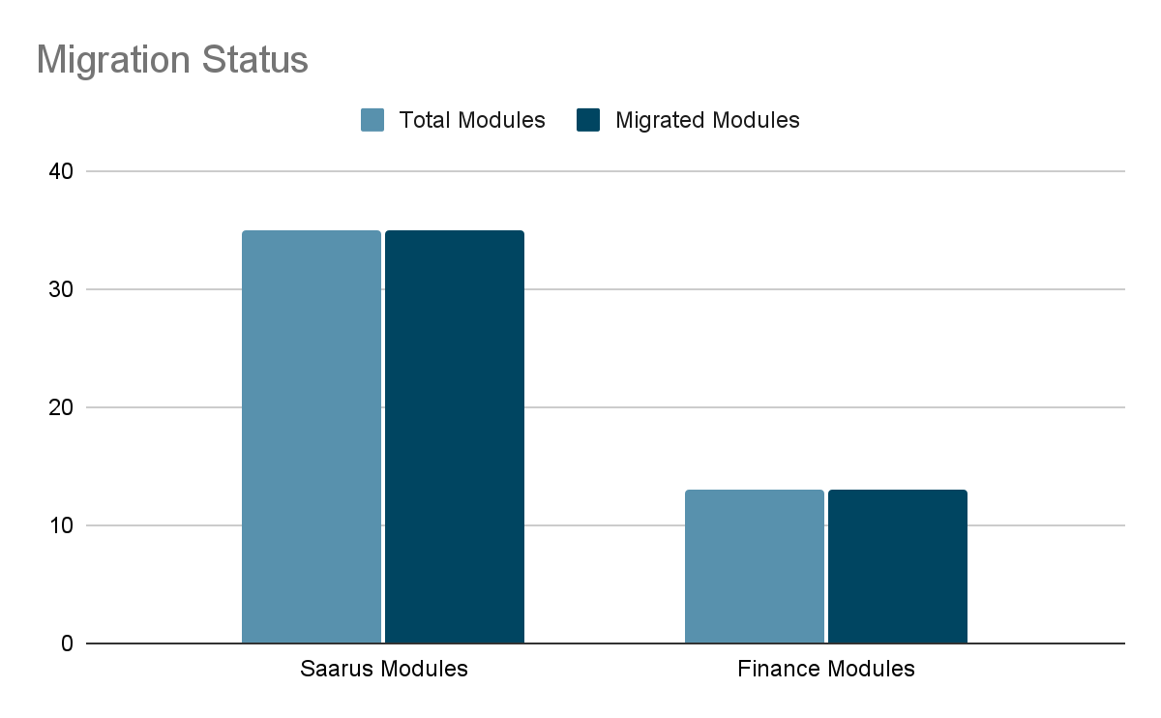
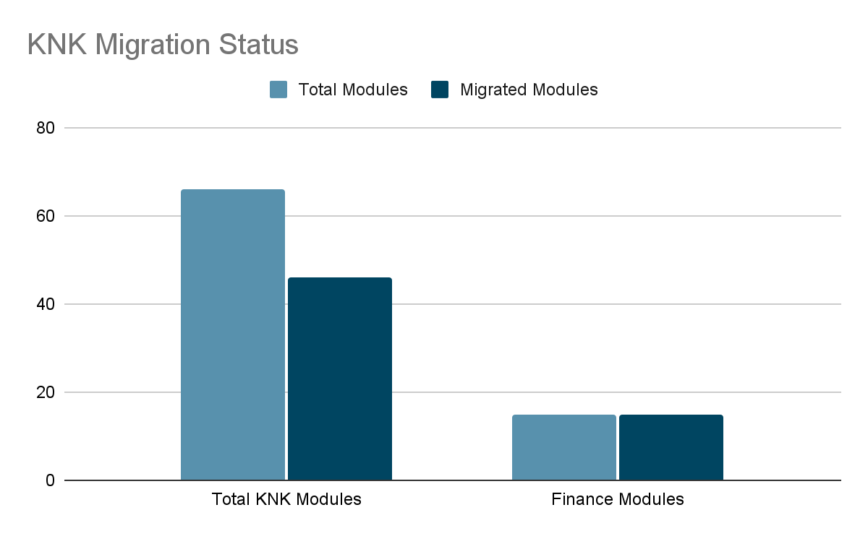
Progress Analysis
Saarus Code Migration Status
KNK Code Migration Status

Slide 7
Risks and Issue
Issue: Considerable delay in the Saarus ERP Completion milestone.
Mitigation: VERTS allocated additional resources to complete Saarus ERP Milestone in week of 9/8.
Issue: VERTS team has not given any feature demonstrations for KNK modules till now,
Mitigation: VERTS agreed to start features demonstration from 10/8 onwards for 2 weeks.

Slide 8
Madhav Agarwal / Siddique Momin
m.agarwal@kokonetworks.com, s.momin@kokonetworks.com

